Slide 1
Basic Processing Unit

Slide 2
Overview
Instruction Set Processor (ISP)
Central Processing Unit (CPU)
A typical computing task consists of a series of steps specified by a sequence of machine instructions that constitute a program.
An instruction is executed by carrying out a sequence of more rudimentary operations.

Slide 3
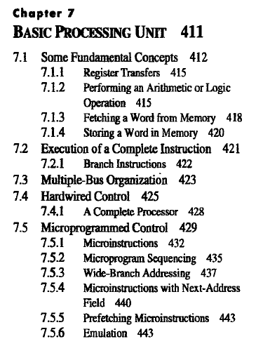

Slide 4
Some Fundamental Concepts

Slide 5
Fundamental Concepts
Processor fetches one instruction at a time and perform the operation specified.
Instructions are fetched from successive memory locations until a branch or a jump instruction is encountered.
Processor keeps track of the address of the memory location containing the next instruction to be fetched using Program Counter (PC).
A branch instruction may load a different value into the PC.
Instruction Register (IR)

Slide 6
Executing an Instruction
To execute an instruction, the processor has to perform the following three steps:
Fetch the contents of the memory location pointed to by the PC. The contents of this location are loaded into the IR (fetch phase).
IR ← [[PC]]
Assuming that the memory is byte addressable, increment the contents of the PC by 4 (fetch phase).
PC ← [PC] + 4
Carry out the actions specified by the instruction in the IR (execution phase).

Slide 7
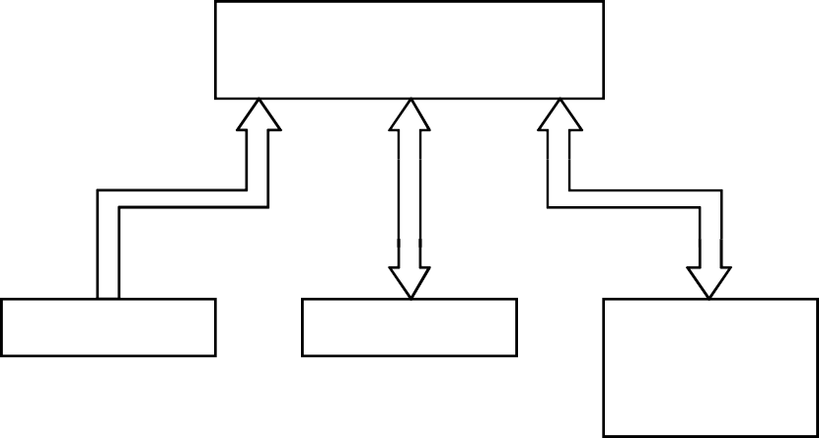
Connection Between the Processor and
the Memory
Memory
MAR
MDR
Control
PC
R₀
R₁
IR
Processor
ALU
^{R}n - 1
n general purpose registers
Figure 2: Connections between the processor and the memory.

Slide 8

Processor Organization
Internal processor bus
Control signals
PC
Instruction decoder and control logic
Address lines
MDR HAS TWO INPUTS AND TWO OUTPUTS
MAR
Memory bus
Data lines
MDR
IR
Datapath
Y
Constant 4
R0
Select
MUX
Add
ALU
control lines
Sub
A B
R n - 1
ALU
XOR
Carry-in
TEMP
Z
Figure 7.1. Single-bus organization of the datapath inside a proc

Slide 9
Executing an Instruction
As instruction execution progresses, data are transferred from one register to another, often passing through the ALU to perform some arithmetic or logic operation.
The instruction decoder and control logic unit is responsible for implementing the actions specified by the instruction loaded in the IR register.
The decoder generates the control signals needed to select the registers involved and direct the transfer of data.
The registers, the ALU, and the interconnecting bus are collectively referred to as the datapath.

Slide 10
Executing an Instruction
With few exceptions, an instruction can be executed by performing one or more of the following operations in some specified sequence:
Transfer a word of data from one processor register to another or to the ALU.
Perform an arithmetic or a logic operation and store the result in a processor register.
Fetch the contents of a given memory location and load them into a processor register.
Store a word of data from a processor register into a given memory location.

Slide 11
Register Transfers
Instruction execution involves a sequence of steps in which data are transferred from one register to another.
For each register, two control signals are used to place the contents of that register on the bus or to load the data on the bus into the register.
The input and output of register Ri are connected to the bus
via switches controlled by the signals Ri_{in} and
^{Ri}out
respectively.
When Ri_{in} is set to 1, the data on the bus are loaded into Ri.
Similarly, when Ri_{out} is set to 1, the contents of register Ri are placed on the bus.
While Ri_{out} is equal to 0, the bus can be used for transferring data from other registers.

Slide 12




Register Transfers
Internal processor
bus
Ri_{in}
Ri
Riout Yin
Y
Constant 4
Select
MUX
A
B
ALU
Zin
Z
Zout
Figure 7.2. Input and output gating for the registers in Figure 7.1.

Slide 13
Register Transfers
All operations and data transfers within the processor take place within time periods defined by the processor clock.
The control signals that govern a particular transfer are asserted at the start of the clock cycle.
An implementation for one bit of register Ri is shown in Figure 7.3 on next slide.
A two-input multiplexer is used to select the data applied to the input of an edge-triggered D flip-flop.
When the control input Ri_{in} is equal to 1, the multiplexer selects the data on the bus. This data will be loaded into the flip-flop at the rising edge of the clock.
When Ri_{in} is equal to 0, the multiplexer feeds back the value currently stored in the fiip-flop.

Slide 14
Register Transfers
All operations and data transfers are controlled by the processor clock.
Bus
0
D
Q
1
Q
^{Ri}out
Ri _{in}
Clock
Figure 7.3. Input and output atingg for one register bit.
Figure 7.3. Input and output gating for one register bit.

Slide 15
Register Transfers
The Q output of the flip-fiop is connected to the bus via a tri-state gate.
When Ri_{out} is equal to 0, the gate's output is in the high- impedance (electrically disconnected) state. This corresponds to the open-circuit state of a switch.
When Ri_{out} = 1, the gate drives the bus to 0 or 1, depending on the value of Q.

Slide 16
Performing an Arithmetic or Logic Operation
The ALU is a combinational circuit that has no internal storage.
ALU gets the two operands from MUX and bus. The result is temporarily stored in register Z.
What is the sequence of operations to add the contents of register R1 to those of R2 and store the result in R3?
❑
R1_{out}, Y_{in}
R2_{out}, SelectY, Add, Z_{in}
Z_{out}, R3_{in}

Slide 17
Performing an Arithmetic or Logic Operation
The signals whose names are given in any step are activated for the duration of the clock cycle corresponding to that step.
All other signals are inactive. Hence, in step 1, the output of register R1 and the input of register Y are enabled, causing the contents of R1 to be transferred over the bus to Y.
In step 2, the multiplexer's Select signal is set to SelectY, causing the multiplexer to gate the contents of register Y to input A of the ALU.
At the same time, the contents of register R2 are gated onto the bus and, hence, to input B.

Slide 18
Performing an Arithmetic or Logic Operation
The function performed by the ALU depends on the signals applied to its control lines.
In this case, the Add line is set to 1, causing the output of the ALU to be the sum of the two numbers at inputs A and B.
This sum is loaded into register Z because its input control signal is activated.
In step 3, the contents of register Z are transferred to the destination register, R3.
This last transfer cannot be carried out during step 2, because only one register output can be connected to the bus during any clock cycle.

Slide 19
Fetching a Word from Memory
To fetch a word of information from memory, the processor has to specify the address of the memory location where this information is stored and request a Read operation.
This applies whether the information to be fetched represents an instruction in a program or an operand specified by an instruction.
The processor transfers the required address to the MAR, whose output is connected to the address lines of the memory bus.

Slide 20
Fetching a Word from Memory
At the same time, the processor uses the control lines of the memory bus to indicate that a Read operation is needed.
When the requested data are received from the memory they are stored in register MDR, from where they can be transferred to other registers in the processor.
The connections for register MDR are illustrated in Figure 7.4 on next slide.
It has four control signals: MDR_{in} and MDR_{out} control the connection to the internal bus, and MDR_{in E} and MDR_{out E} control the connection to the external bus.

Slide 21
Fetching a Word from Memory
Address into MAR; issue Read operation; data into MDR.
Memory-bus data lines
Internal process bus
^{MDR}outE
MDR_{out}
MDR
MDR_{inE}
MDR_{in}
Figure 7.4. Connection and control signals for register MDR.
Figure 7.4. Connection and control signals fogisterr re MDR.

Slide 22
Fetching a Word from Memory
The processor completes one internal data transfer in one clock cycle.
The speed of operation of the addressed device, on the other hand, varies with the device.
Typically, a cache will respond to a memory read request in one clock cycle. However, when a cache miss occurs, the request is forwarded to the main memory, which introduces a delay of several clock cycles.
So, the response time of each memory access varies (cache miss, memory-mapped I/O,…).
To accommodate this, the processor waits until it receives an indication that the requested operation has been completed (Memory-Function-Completed, MFC).

Slide 23
Fetching a Word from Memory
As an example of a read operation, consider the instruction Move (R1), R2. The actions needed to execute this instruction are:
MAR ← [R1]
Start a Read operation on the memory bus
Wait for the MFC response from the memory
Load MDR from the memory bus
R2 ← [MDR]
These actions may be carried out as separate steps, but some can be combined into a single step.
Each action can be completed in one clock cycle, except action 3 which requires one or more clock cycles, depending on the speed of the addressed device.

Slide 24
Fetching a Word from Memory
let us assume that the output of MAR is enabled all the time. Thus, the contents of MAR are always available on the address lines of the memory bus.
When a new address is loaded into MAR, it will appear on the memory bus at the beginning of the next clock cycle, as shown in Figure 7.5 on next slide.
A Read control signal is activated at the same time MAR is loaded. This signal will cause the bus interface circuit to send a read command, MR, on the bus. With this arrangement, we have combined actions 1 and 2 above into a single control step.
Actions 3 and 4 can also be combined by activating control signal MDR_{inE} while waiting for a response from the memory.

Slide 25
Fetching a Word from Memory
Thus, the data received from the memory are loaded into MDR at the end of the clock cycle in which the MFC signal is received.
In the next clock cycle, MDR_{out} is activated to transfer the data to register R2.
This means that the memory read operation requires three steps, which can be described by the signals being activated as follows:
R1_{out,}MAR_{in}, Read
MDR_{in E,} WMFC
MDR_{out} R2_{in}

Slide 26
Timing
Step
1
2
3
Clock
MAR_{in}
 |  |  |  |  | ← [R1]
 |  |  |  | MAR
Assume MAR
is always available on the address lines of the memory bus.
Address
Start a Read operation on the memory bus
Read
MR
MDR_{inE}
Data
Wait for the MFC response from th
e memory
MFC
Load MDR from
the memory bus
MDR_{out}
R2 ← [MDR]
Figure 7.5. Timing of a memory Read operation.

Slide 27
Storing a Word in Memory
The desired address is loaded into MAR.
Then, the data to be written are loaded into MDR, and a Write command is issued.
Hence, executing the instruction Move R2,(Rl) requires the following sequence:
R1_{out,}MAR_{in}
R2_{out,} MDR_{in,} Write
MDR_{out E,} WMFC
The processor remains in step 3 until the memory operation is completed and an MFC response is received.

Slide 28
Execution of a Complete Instruction
Consider the instruction
Add (R3), R1
Executing this instruction requires the following actions:
Fetch the instruction
Fetch the first operand (the contents of the memory location pointed to by R3)
Perform the addition
Load the result into R1

Slide 29
Execution of a Complete Instruction
Internal processor bus
Add (R3), R1
Control signals
PC
Instruction decoder and control logic
Step
Action
Address lines
1
2
3
4
5
6
7
PC_{out} , MAR _{in} , Read, Select4,Add, Z_{in} Zout , PCin , Yin , WMF C
MDR _{out} , IR _{in}
R3out , MAR in , Read R1out , Yin , WMF C
MAR
Memory bus
Data lines
MDR
IR
Y
Constant 4
R0
MDR _{out} , SelectY, Add, Z_{in} Zout , R1in , End
Select
MUX
Add
ALU
control lines
Sub
A B
R n - 1
ALU
XOR
Carry-in
Figure 7.6. Control sequencefor execution of the instruction Add (R3),R1.
TEMP
Z
Figure 7.1. Single-bus organization of the datapath inside a proc

Slide 30
Execution of a Complete Instruction
In step 1, the instruction fetch operation is initiated by loading the contents of the PC into the MAR and sending a Read request to the memory.
The Select signal is set to Select4, which causes the multiplexer MUX to select the constant 4. This value is added to the operand at input B, which is the contents of the PC, and the result is stored in register Z.
The updated value is moved from register Z back into the PC during step 2, while waiting for the memory to respond.
In step 3, the word fetched from the memory is loaded into the IR.
Steps 1 through 3 constitute the instruction fetch phase, which is the same for all instructions.

Slide 31
Execution of a Complete Instruction
The instruction decoding circuit interprets the contents of the IR at the beginning of step 4.
This enables the control circuitry to activate the control signals for steps 4 through 7, which constitute the execution phase.
The contents of register R3 are transferred to the MAR in step 4, and a memory read operation is initiated.
Then the contents of R1 are transferred to register Y in step 5, to prepare for the addition operation.
When the Read operation is completed, the memory operand is available in register MDR, and the addition operation is performed in step 6.

Slide 32
Execution of a Complete Instruction
The contents of MDR are gated to the bus, and thus also to the B input of the ALU, and register Y is selected as the second input to the ALU by choosing SelectY.
The sum is stored in register Z, then transferred to R1 in step 7.
The End signal causes a new instruction fetch cycle to begin by returning to step 1.
This discussion accounts for all control signals except Y_{in} in step 2.
There is no need to copy the updated contents of PC into register Y when executing the Add instruction.
But, in Branch instructions the updated value of the PC is needed to compute the Branch target address.

Slide 33
Execution of a Complete Instruction
To speed up the execution of Branch instructions, this value is copied into register Y in step 2.
Since step 2 is part of the fetch phase, the same action will be performed for all instructions. This does not cause any harm because register Y is not used for any other purpose at that time.

Slide 34
Execution of Branch Instructions
A branch instruction replaces the contents of PC with the branch target address, which is usually obtained by adding an offset X given in the branch instruction.
Step Action
1
2
3
4
5
PC_{out} , MAR _{in} , Read, Select4,Add, Zin Z_{out}, PC_{in} , Y_{in}, WMF C
MDR_{out} , IR_{in}
Offset-field-of-IRout, Add, Zin Z_{out}, PC_{in} , End
Figure 7.7. Control sequence for an unconditional branch instruction.

Slide 35
Execution of Branch Instructions
Processing starts, as usual, with the fetch phase. This phase ends when the instruction is loaded into the IR in step 3.
The offset value is extracted from the IR by the instruction decoding circuit, which will also perform sign extension if required.
Since the value of the updated PC is already available in register Y, the offset X is gated onto the bus in step 4, and an addition operation is performed.
The result, which is the branch target address, is loaded into the PC in step 5.
The offset X is usually the difference between the branch target address and the address immediately following the branch instruction.

Slide 36
Execution of Conditional Branch
Instructions
Conditional branch
In this case, we need to check the status of the condition codes before loading a new value into the PC.
For example, for a Branch-on negative (Branch<O) instruction, step 4 in Figure 7.7 is replaced with
Offset-field-of-IR_{out}, Add, Z_{in}, If N = 0 then End
Thus, if N = 0 the processor returns to step 1 immediately after step 4.
If N = 1, step 5 is performed to load a new value into the PC, thus performing the branch operation.

Slide 37
Execution of Conditional Branch
Instructions
Step Action
1
2
3
4
5
PC_{out} , MAR _{in} , Read, Select4,Add, Zin Z_{out}, PC_{in} , Y_{in}, WMF C
MDR_{out} , IR_{in}
Offset-field-of-IRout, Add, Zin If N = 0 then End Z_{out}, PC_{in} , End
Figure. Control sequence for an conditional branch instruction.

Slide 38

Multiple-Bus Organization
Till now, we have considered the simple single-bus structure of processing unit to illustrate the basic ideas.
Bus A
Bus B
Bus C
Incrementer
PC
Register file
The resulting control sequence to execute a instruction is quite long because only one data item can be transferred over the bus in a clock cycle.
Constant 4
MUX
A
ALU
R
B
Instruction decoder
To reduce the number of steps needed, most commercial processors provide multiple internal paths that enable several transfers to take place in parallel.
IR
MDR
MAR
Memory bus data lines
Address lines
Figure 7.8. Three-bus organization of the datapath.

Slide 39
Multiple-Bus Organization
All general-purpose registers are combined into a single block called the register file.
The register file in Figure 7.8 is said to have three ports.
There are two outputs, allowing the contents of two different registers to be accessed simultaneously and have their contents placed on buses A and B.
The third port allows the data on bus C to be loaded into a third register during the same clock cycle.
Buses A and B are used to transfer the source operands to the A and B inputs of the ALU, where an arithmetic or logic operation may be performed.
The result is transferred to the destination over bus C.

Slide 40
Multiple-Bus Organization
If needed, the ALU may simply pass one of its two input operands unmodified to bus C.
We will call the ALU control signals for such an operation R=A or R=B.
The three-bus arrangement obviates the need for registers Y and Z as required in single-bus structure processing unit.
A second feature in
Multiple-Bus
Organization is the
introduction of the Incrementer unit, which is used to increment the PC by 4.
Using the Incrementer eliminates the need to add 4 to the PC using the main ALU.
The source for the constant 4 at the ALU input multiplexer is still useful.

Slide 41
Multiple-Bus Organization
It can be used to increment other addresses, such as the memory addresses in LoadMultiple and StoreMultiple instructions.
Consider the three-operand instruction
Add R4,R5,R6
The control sequence for executing this instruction is given on next slide.

Slide 42
Multiple-Bus Organization
Add R4, R5, R6
Step Action
1
2
3
4
PC_{out}, WMFC
R=B, MAR _{in} , Read, IncPC
MDR_{outB}, R=B, IR in
R4outA, R5outB,
SelectA, Add, R6_{in} , End
Figure 7.9. Control sequence for the instruction. Add R4,R5,R6, for the three-bus organization in Figure 7.8.

Slide 43
Multiple-Bus Organization
In step 1, the contents of the PC are passed through the ALU, using the R=B control signal, and loaded into the MAR to start a memory read operation.
At the same time the PC is incremented by 4.
In step 2, the processor waits for MFC and loads the data received into MDR, then transfers them to IR in step 3.
Finally, the execution phase of the instruction requires only one control step to complete, step 4.
By providing more paths for data transfer a significant reduction in the number of clock cycles needed to execute an instruction is achieved.

Slide 44
Hardwired Control

Slide 45
Overview
To execute instructions, the processor must have some means of generating the control signals needed in the proper sequence.
Two categories: hardwired control and microprogrammed control
Hardwired system can operate at high speed; but with little flexibility.

Slide 46
Control Unit Organization
Clock
CLK
Control step counter
External inputs
Decoder/ encoder
IR
Condition codes
Control signals
Figure 7.10. Control unit organization.

Slide 47
Hardwired Control
A counter may be used to keep track of the control steps, as shown in Figure 7.10 on previous slide.
Each state, or count, of this counter corresponds to one control step.
The required control signals are determined by the following information:
Contents of the control step counter
Contents of the instruction register
Contents of the condition code flags
External input signals, such as MFC and interrupt requests
The decoder/encoder block in Figure 7.10 is a combinational circuit that generates the required control outputs, depending on the state of all its inputs.
By separating the decoding and encoding functions, we obtain the more detailed block diagram as shown in Figure 7.11. on next slide.

Slide 48
Detailed Block Description
Clock
CLK
Control step counter
Reset
Step decoder
T₁ T₂ T_{n}
IR
Instruction decoder | INS₁
 | INS₂
Encoder
External inputs
Condition codes
INS_{m}
Run
End
Control signals
Figure 7.11. Separation of the decoding and encoding functio

Slide 49
Hardwired Control
The step decoder provides a separate signal line for each step, or time slot, in the control sequence.
Similarly, the output of the instruction decoder consists of a separate line for each machine instruction.
For any instruction loaded in the IR, one of the output lines INS₁ through INS_{m} is set to 1, and all other lines are set to 0.
The input signals to the encoder block in Figure 7.11 are combined to generate the individual control signals Y_{in}, PC_{out}, Add, End, and so on.
An example of how the encoder generates the Z_{in} control signal for the processor organization in Figure 7.1 is given in Figure 7.12. on next slide

Slide 50
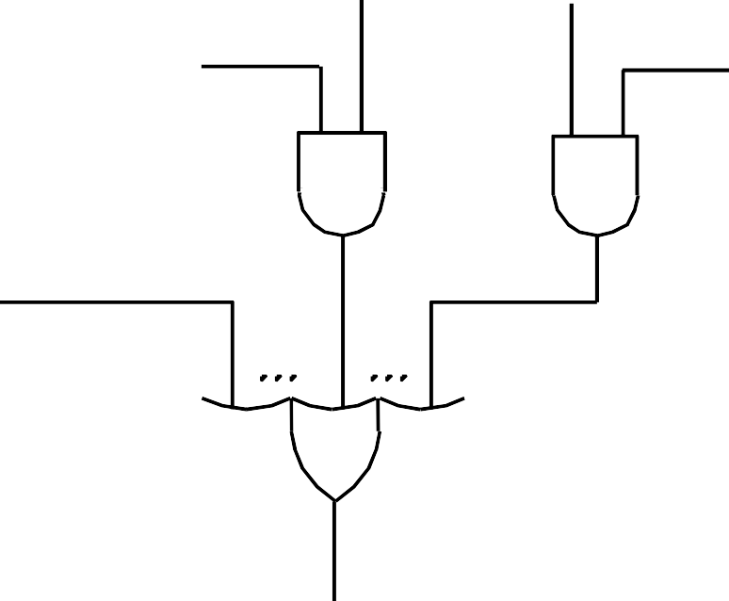
Generating Z_{in}
This circuit implements the logic function
Z_{in} = T₁ + T₆ • ADD + T₄ • BR + …
Branch
Add
This
signal is
asserted during
T₄
T₆
time slot T1 for all instructions,
during Add during
T6 for an
instruction,
T₁
T4 for an
unconditional branch instruction, and so on.
Figure 7.12. Generation of the Z_{in} control signal for the processor in Figure 7.1.

Slide 51





Generating End
End = T7 • ADD + T5 • BR + (T5 • N + T4 • N) • BRN +…
Branch<0
Add
N
Branch
N
T₇
T₅
T₄
T₅
End
Figure 7.13. Generation of the End control signal.

Slide 52

A Complete Processor
Instruction unit
Integer unit
Floating-point unit
Instruction cache
Data cache
Bus interface
Processor
System bus
Main memory
Input/ Output
Figure 7.14. Block diagram of a complete proces.sor

Slide 53
A Complete Processor
This structure has an instruction unit that fetches instructions from an instruction cache or from the main memory when the desired instructions are not already in the cache.
It has separate processing units to deal with integer data and floating-point data.
A data cache is inserted between these units and the main memory.
Using separate caches for instructions and data is common practice in many processors today. Other processors use a single cache that stores both instructions and data.
The processor is connected to the system bus and, hence, to the rest of the computer, by means of a bus interface.

Slide 54
Microprogrammed Control

Slide 55
Microprogrammed Control
Control signals are generated by a program similar to machine language programs.
Control Word (CW); microroutine; microinstruction
A control word (CW) is a word whose individual bits represent the various control signals in Figure 7.11.
Each of the control steps in the control sequence of an instruction defines a unique combination of 1s and 0s in the CW.
The CWs corresponding to the 7 steps of Figure 7.6 are shown in Figure 7.15 on the next slides.
We have assumed that SelectY is represented by Select = 0 and Select4 by Select = 1.

Slide 56
Microprogrammed Control
Step
Action
1
2
3
4
5
6
7
PC_{out} , MAR _{in} , Read, Select4,Add, Z_{in} Zout , PCin , Yin , WMF C
MDR _{out} , IR _{in}
R3out , MAR in , Read R1out , Yin , WMF C MDR _{out} , SelectY, Add, Z_{in} Zout , R1in , End
Figure 7.6. Control sequencefor execution of the instruction Add (R3),R1.

Slide 57
Microprogrammed Control
Micro - nstruction |  | PC_{in} | ^{PC}out | MAR _{in} | Read | MDR_{out} | IR_{in} | ^{Y}in | Select | Add | ^{Z}in | ^{Z}out | ^{R1}out | R1_{in} | ^{R3}out | WMFC | End
1 |  | 0 | 1 | 1 | 1 | 0 | 0 | 0 | 1 | 1 | 1 | 0 | 0 | 0 | 0 | 0 | 0
2 |  | 1 | 0 | 0 | 0 | 0 | 0 | 1 | 0 | 0 | 0 | 1 | 0 | 0 | 0 | 1 | 0
3 |  | 0 | 0 | 0 | 0 | 1 | 1 | 0 | 0 | 0 | 0 | 0 | 0 | 0 | 0 | 0 | 0
4 |  | 0 | 0 | 1 | 1 | 0 | 0 | 0 | 0 | 0 | 0 | 0 | 0 | 0 | 1 | 0 | 0
5 |  | 0 | 0 | 0 | 0 | 0 | 0 | 1 | 0 | 0 | 0 | 0 | 1 | 0 | 0 | 1 | 0
6 |  | 0 | 0 | 0 | 0 | 1 | 0 | 0 | 0 | 1 | 1 | 0 | 0 | 0 | 0 | 0 | 0
7 |  | 0 | 0 | 0 | 0 | 0 | 0 | 0 | 0 | 0 | 0 | 1 | 0 | 1 | 0 | 0 | 1
i
Figure 7.15 An example of microinstructions for Figure 7.6.

Slide 58
Microprogrammed Control
A sequence of CWs corresponding to the control sequence of a machine instruction constitutes the microroutine for that instruction, and the individual control words in this microroutine are referred to as microinstructions.
The microroutines for all instructions in the instruction set of a computer are stored in a special memory called the control store.
The control unit can generate the control signals for any instruction by sequentially reading the CWs of the corresponding microroutine from the control store.
This suggests organizing the control unit as shown in Figure
7.16. on next slide.

Slide 59
Microprogrammed Control
Starting address generator
IR
One function cannot be carried out by this simple organization.
Clock
mPC
Control store
CW
Figure 7.16. Basic organization of a microprogrammed control

Slide 60
Microprogrammed Control
To read the control words sequentially from the control store, a micro program counter (μPC) is used.
Every time a new instruction is loaded into the IR, the output of the block labeled "starting address generator'' is loaded into the μPC.
The μPC is then automatically incremented by the clock, causing successive microinstructions to be read from the control store.
Hence, the control signals are delivered to various parts of the processor in the correct sequence.

Slide 61
Microprogrammed Control
The previous organization cannot handle the situation when the control unit is required to check the status of the condition codes or external inputs to choose between alternative courses of action.
In microprogrammed control, this situation is handled by using conditional branch microinstruction.
Address Microinstruction
0
1
2
3
PC_{out} , MAR _{in} , Read, Select4,Add, Z_{in} Z_{out} , PC_{in} , Y_{in} , WMFC
MDR_{out} , IR_{in}
Branch to starting address of appropriate microroutine
. . . . . . . . . . . . . . . . . . . . . . . . . . . . . . . . . . . . . . . . . . . . . . . . . . . . . . . . . . . . . . . . . .
25
26
27
If N=0, then branch to microinstruction 0 Offset-field-of-IR_{out} , SelectY, Add, Z_{in} Z_{out} , PC_{in} , End
Figure 7.17. Microroutine for the instruction Branch<0.

Slide 62
Microprogrammed Control
The instruction Branch<0 may now be implemented by a microroutine such as that shown in Figure 7.17.
After loading this instruction into IR, a branch microinstruction transfers control to the corresponding microroutine, which is assumed to start at location 25 in the control store.
This address is the output of the starting address generator block in Figure 7.16.
The microinstruction at location 25 tests N bit of the condition codes. If this bit is equal to 0, a branch takes place to location 0 to fetch a new machine instruction.
Otherwise, the microinstruction at location 26 is executed to put the branch target address into register Z.
The microinstruction in location 27 loads this address into the PC.

Slide 63
Microprogrammed Control
External inputs
Starting and branch address
generator
IR
Condition codes
Clock
mPC
Control store
CW
Figure 7.18.
Organization of the control unit to allow conditional branching in the microprogram.

Slide 64
Microprogrammed Control
To support microprogram branching, the organization of the control unit should be modified as shown in Figure 7.18 on previous slide.
The starting address generator block of Figure 7.16 becomes the starting and branch address generator.
This block loads a new address into the μPC when a microinstruction instructs it to do so.
To allow implementation of a conditional branch, inputs to this block consist of the external inputs and condition codes as well as the contents of the instruction register.

Slide 65
Microprogrammed Control
In this control unit, the μPC is incremented every time a new microinstruction is fetched from the microprogram memory, except in the following situations:
When a new instruction is loaded into the IR, the μPC is loaded with the starting address of the microroutine for that instruction.
When a Branch microinstruction is encountered and the branch condition is satisfied, the μPC is loaded with the branch address.
When an End microinstruction is encountered, the μPC is loaded with the address of the first CW in the microroutine for the instruction fetch cycle (this address is 0 in Figure 7.17).

Slide 66
Microinstructions
A straightforward way to structure microinstructions is to assign one bit position to each control signal.
However, this is very inefficient.
Assigning individual bits to each control signal results in long microinstructions because the number of required signals is usually large.
Moreover, only a few bits are set to 1 (to be used for active gating) in any given microinstruction, which means the available bit space is poorly used.
The length can be reduced: most signals are not needed simultaneously, and many signals are mutually exclusive.
All mutually exclusive signals are placed in the same group in binary coding.

Slide 67
Processor Organization
Internal processor bus
Control signals
PC
Instruction decoder and control logic
Address lines
MDR HAS TWO INPUTS AND TWO OUTPUTS
MAR
Memory bus
Data lines
MDR
IR
Datapath
Y
Constant 4
R0
Select
MUX
Add
ALU
control lines
Sub
A B
R n - 1
ALU
XOR
Carry-in
TEMP
Z
Figure 7.1. Single-bus organization of the datapath inside a proc

Slide 68
Microinstructions
Consider again the simple processor of Figure 7.1, and assume that it contains only four general-purpose registers, R0, R1, R2, and R3.
Some of the connections in this processor are permanently enabled, such as the output of the IR to the decoding circuits and both inputs to the ALU.
The remaining connections to various registers require a total of 20 gating signals.
Additional control signals not shown in the figure are also needed, including the Read, Write, Select, WMFC, and End signals.
Finally, we must specify the function to be performed by the ALU. Let us assume that 16 functions are provided, including Add, Subtract, AND, and XOR.
These functions depend on the particular ALU used and do not necessarily have a one-to-one correspondence with the machine instruction OP codes.
In total, 42 control signals are needed.

Slide 69
Microinstructions
If we use the simple encoding scheme described earlier, 42 bits would be needed in each microinstruction.
Fortunately, the length can be reduced: most signals are not needed simultaneously, and many signals are mutually exclusive.
All mutually exclusive signals are placed in the same group in binary coding.
For example, only one function of the ALU can be activated at a time.
The source for a data transfer must be unique because it is not possible to gate the contents of two different registers onto the bus at the same time.

Slide 70
Microinstructions
Read and Write signals to the memory cannot be active simultaneously.
This suggests that signals can be grouped so that all mutually exclusive signals are placed in the same group.
Thus, at most one microoperation per group is specified in any microinstruction. Then it is possible to use a binary coding scheme to represent the signals within a group.

Slide 71
Partial Format for the Microinstructions
Microinstruction
F1 | F2 | F3 | F4 | F5
F1 (4 bits)
F2 (3 bits)
F3 (3 bits)
F4 (4 bits)
F5 (2 bits)
0000: No transfer
0001: PC _{out}
000: No transfer
001: PC _{in}
000: No transfer
0000: Add
0001: Sub
00: No action
01: Read
001: MAR
in
0010: MDR | out | 010: IR _{in} | 010: MDR | in |  | 10: Write
0011: Z _{out} 0100: R0 _{out} |  | 011: Z _{in} 100: R0 _{in} | 011: TEMP 100: Y _{in} | in | 1111: XOR
0101: R1 _{out} |  | 101: R1 _{in}
0110: R2 _{out} |  | 110: R2 _{in} | 16 ALU functions
0111: R3 _{out} |  | 111: R3 _{in}
1010: TEMP | out
1011: Offset | out
F6
F7
F8
What is the price paid for this scheme?
F6 (1 bit)
F7 (1 bit)
F8 (1 bit)
0: SelectY
1: Select4
0: No action
1: WMFC
0: Continue
1: End
Figure 7.19.
An example of a partial format for field-encoded microinstructions.

Slide 72
Microinstructions
Grouping control signals into fields requires a little more hardware because decoding circuits must be used to decode the bit patterns of each field into individual control signals.
The cost of this additional hardware is more than offset by the reduced number of bits in each microinstruction, which results in a smaller Control store.
In Figure 7.19, only 20 bits are needed to store the patterns for the 42 signals.

Slide 73
Further Improvement
Enumerate the patterns of required signals in all possible microinstructions. Each meaningful combination of active control signals can then be assigned a distinct code.
Such full encoding is likely to further reduce the length of microwords but also to increase the complexity of the required decoder circuits.
There are two encoding schems:
Vertical organization
Horizontal organization
Highly encoded schemes that use compact codes to specify only a small number of control functions in each microinstruction are referred to as a vertical organization.

Slide 74
Further Improvement
On the other hand, the minimally encoded scheme of Figure 7.15, in which many resources can be controlled with a single microinstruction, is called a horizontal organization.
The horizontal approach is useful when a higher operating speed is desired and when the machine structure allows parallel use of resources.
The vertical approach results in considerably slower operating speeds because more microinstructions are needed to perform the desired control functions.
Although fewer bits are required for each microinstruction, this does not imply that the total number of bits in the control store is smaller. The significant factor is that less hardware is needed to handle the execution of microinstructions.

Slide 75
Microprogram Sequencing
If all microprograms require only
straightforward
sequential execution of microinstructions except for branches, letting a μPC governs the sequencing would be efficient.
However, two disadvantages:
Having a
separate microroutine for each machine results in a large total number of
instruction
microinstructions and a large control store.
Longer execution time because it takes more time to carry out the required branches.
Example: Add src, Rdst
Four addressing
modes: register, autoincrement,
autodecrement, and indexed (with indirect forms).

Slide 76
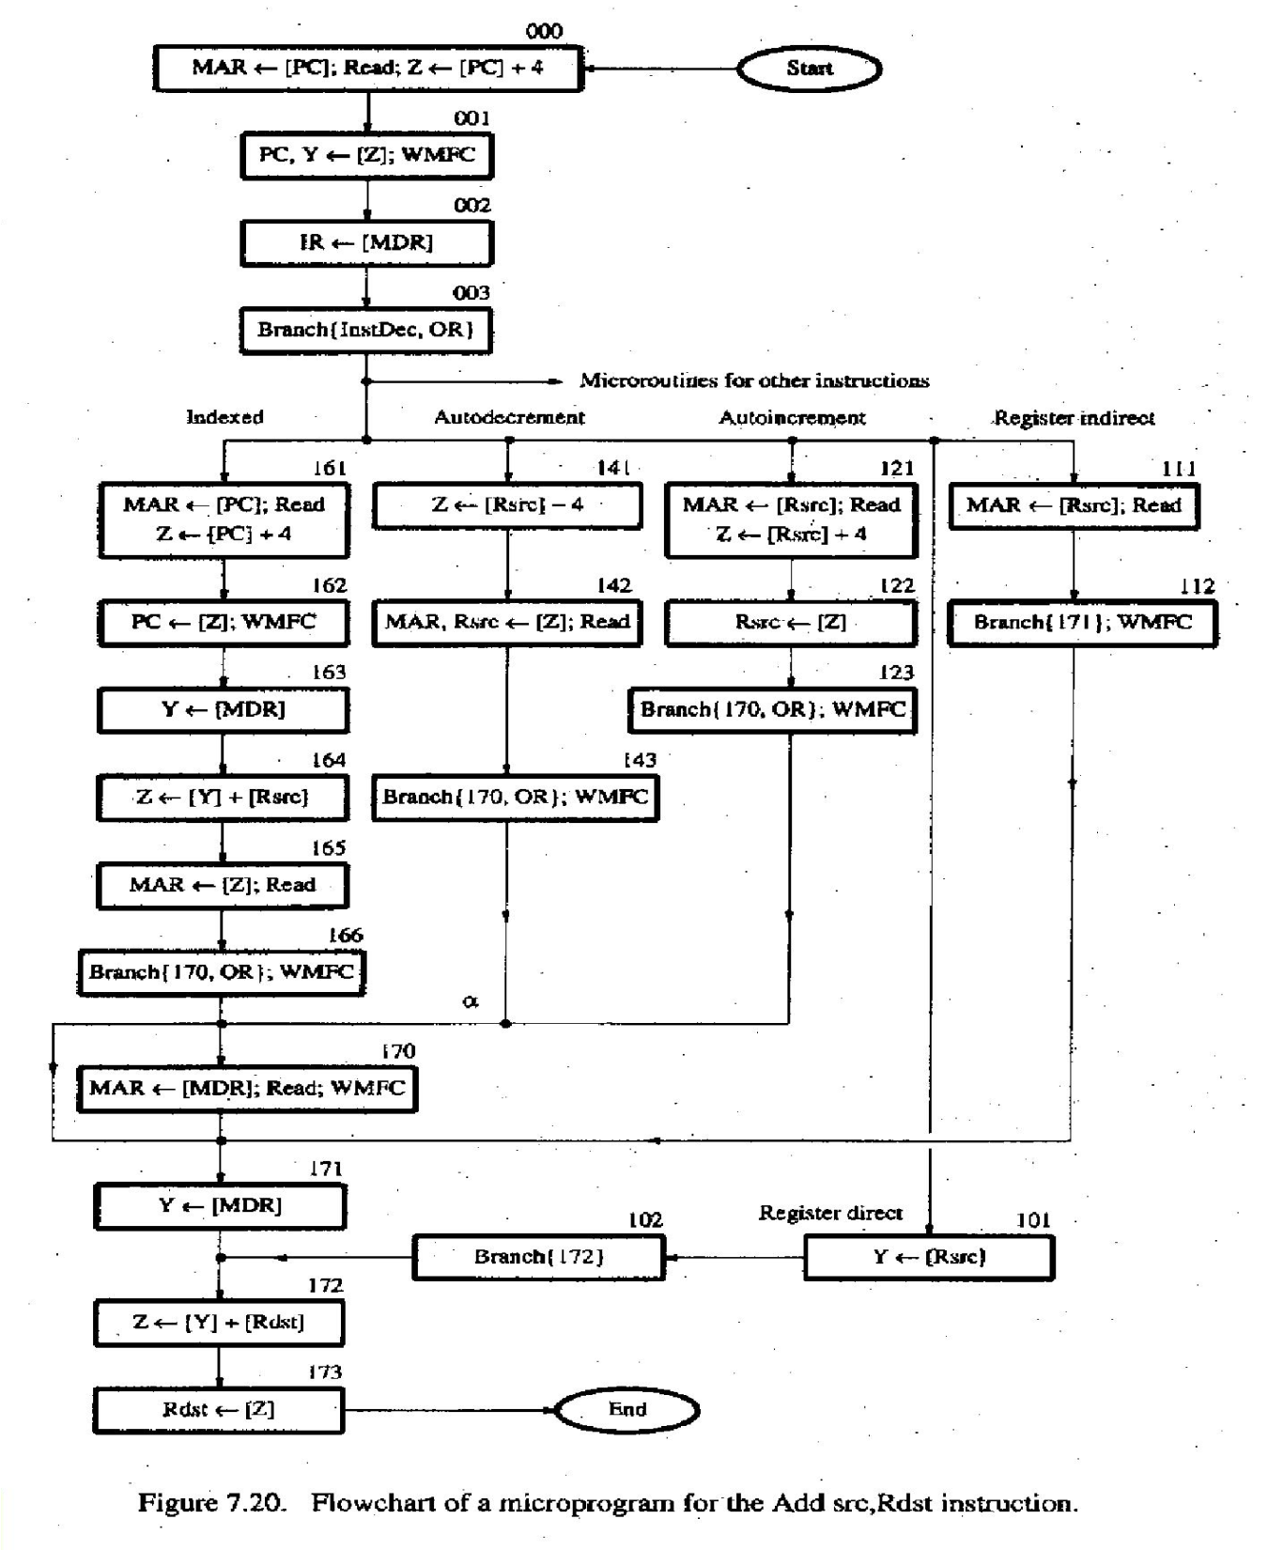
Bit-ORing
Wide-Branch Addressing
WMFC

Slide 77
Mode
Contents of IR
OP code
0 1 0
Rsrc
Rdst
11 10 8 7 4 3
0
Address (octal)
Microinstruction
000
001
002
003
PC_{out}, MAR_{in}, Read, Selec4t, Add, Z_{in} Z_{out}, PC_{in}, Y_{in}, WMFC
MDR_{out}, IR_{in}
mBranch {m PC 101 (from Instruction decoder);
mPC_{5,4}  [IR_{10,9}]; mPC₃  [IR10]  [IR9]  [IR8]}
Rsrc_{out}, MAR_{in}, Read, Select4, Add,inZ Z_{out}, Rsrc_{in}
mBranch {mPC 170;mPC₀  [IR₈]}, WMFC
MDR_{out}, MAR_{in}, Read, WMFC MDR_{out}, Y_{in}
Rds_{o}t_{ut}, SelectY, Add, Z_{in} Z_{out}, Rds_{i}t_{n}, End
121
122
123
170
171
172
173
Figure 7.21. Microinstruction for Add (Rsrc)+,Rdst.
Note:Microinstruction at location 170 is not executed for this addressing mode.

Slide 78
Microinstructions with Next-Address Field
The microprogram we discussed requires several branch microinstructions, which perform no useful operation in the datapath.
A powerful alternative approach is to include an address field as a part of every microinstruction to indicate the location of the next microinstruction to be fetched.
Pros: separate branch microinstructions are virtually eliminated; few limitations in assigning addresses to microinstructions.
Cons: additional bits for the address field (around 1/6)

Slide 79







Microinstructions with Next-Address Field
IR
External Inputs
Condition codes
Decoding circuits
 |  | m AR Control store
Next address
mI R
Microinstruction decoder
Control signals
Figure 7.22. Microinstruction-sequencing organization.

Slide 80
Microinstruction
F0 | F1 | F2 | F3
F0 (8 bits)
F1 (3 bits) F2 (3 bits)
F3 (3 bits)
Address of next microinstruction
000: No transfer 000: No transfer
000: No transfer
001: MAR_{in}
010: MDR_{in}
011: TEMP_{in}
100: Y_{in}
001: PC_{out}
010: MDR_{out} 011: Z_{out} 100: Rsrc_{out}
101: Rds_{o}t_{ut}
110: TEMP_{out}
001: PC_{in}
010: IR_{in}
011: Z_{in}
100: Rsrc_{in}
101: Rds_{i}t_{n}
F4 | F5 | F6 | F7
F4 (4 bits) | F5 (2 bits) | F6 (1 bit) | F7 (1 bit)
0000: Add | 00: No action | 0: SelectY | 0: No action
0001: Sub | 01: Read 10: Write | 1: Select4 | 1: WMFC
1111: XOR
F8 | F9 | F10
F8 (1 bit)
F9 (1 bit)
F10 (1 bit)
0: NextAdrs
1: InstDec
0: No action
1: OR_{mode}
0: No action
^{1: OR}indsrc
Figure 7.23. Format for microinstructions in the example of Section 7

Slide 81
Implementation of the Microroutine
Octal ddres | s F0 | F1 | F2 | F3 | F4 | F5 | F6 | F7 | F8 | F9 | F1
0 0 0 | 0 0 0 0 0 0 0 1 | 0 0 1 | 0 1 1 | 0 0 1 | 0 0 0 0 | 0 1 | 1 | 0 | 0 | 0 | 0
0 0 1 | 0 0 0 0 0 0 1 0 | 0 1 1 | 0 0 1 | 1 0 0 | 0 0 0 0 | 0 0 | 0 | 1 | 0 | 0 | 0
0 0 2 | 0 0 0 0 0 0 1 1 | 0 1 0 | 0 1 0 | 0 0 0 | 0 0 0 0 | 0 0 | 0 | 0 | 0 | 0 | 0
0 0 3 | 0 0 0 0 0 0 0 0 | 0 0 0 | 0 0 0 | 0 0 0 | 0 0 0 0 | 0 0 | 0 | 0 | 1 | 1 | 0
1 2 1 | 0 1 0 1 0 0 1 0 | 1 0 0 | 0 1 1 | 0 0 1 | 0 0 0 0 | 0 1 | 1 | 0 | 0 | 0 | 0
1 2 2 | 0 1 1 1 1 0 0 0 | 0 1 1 | 1 0 0 | 0 0 0 | 0 0 0 0 | 0 0 | 0 | 1 | 0 | 0 | 1
1 7 0 | 0 1 1 1 1 0 0 1 | 0 1 0 | 0 0 0 | 0 0 1 | 0 0 0 0 | 0 1 | 0 | 1 | 0 | 0 | 0
1 7 1 | 0 1 1 1 1 0 1 0 | 0 1 0 | 0 0 0 | 1 0 0 | 0 0 0 0 | 0 0 | 0 | 0 | 0 | 0 | 0
1 7 2 | 0 1 1 1 1 0 1 1 | 1 0 1 | 0 1 1 | 0 0 0 | 0 0 0 0 | 0 0 | 0 | 0 | 0 | 0 | 0
1 7 3 | 0 0 0 0 0 0 0 0 | 0 1 1 | 1 0 1 | 0 0 0 | 0 0 0 0 | 0 0 | 0 | 0 | 0 | 0 | 0
a
0
Figure 7.24. Implementation of the microroutine of Figure 7.21 usi next-microinstruction address fie(ldS.ee Figure 7.23 for encoded sign

Slide 82









R15_{in} R15_{out}
R0_{in}
^{R0}out
Decoder
Decoder
IR
Rsrc
Rdst
External inputs
InstDec_{out}
Decoding circuits
^{OR}mode
Condition codes
OR
indsrc
mAR
Control store
Next address
F1 F2
F8 F9 F10
Rdst_{out}
Rdst_{in}
Microinstruction
Rsrc_{out}
decoder
Rsrc_{in}
Other control signals
Figure 7.25. Some details of the control-signal-generating circuitry.

Slide 83
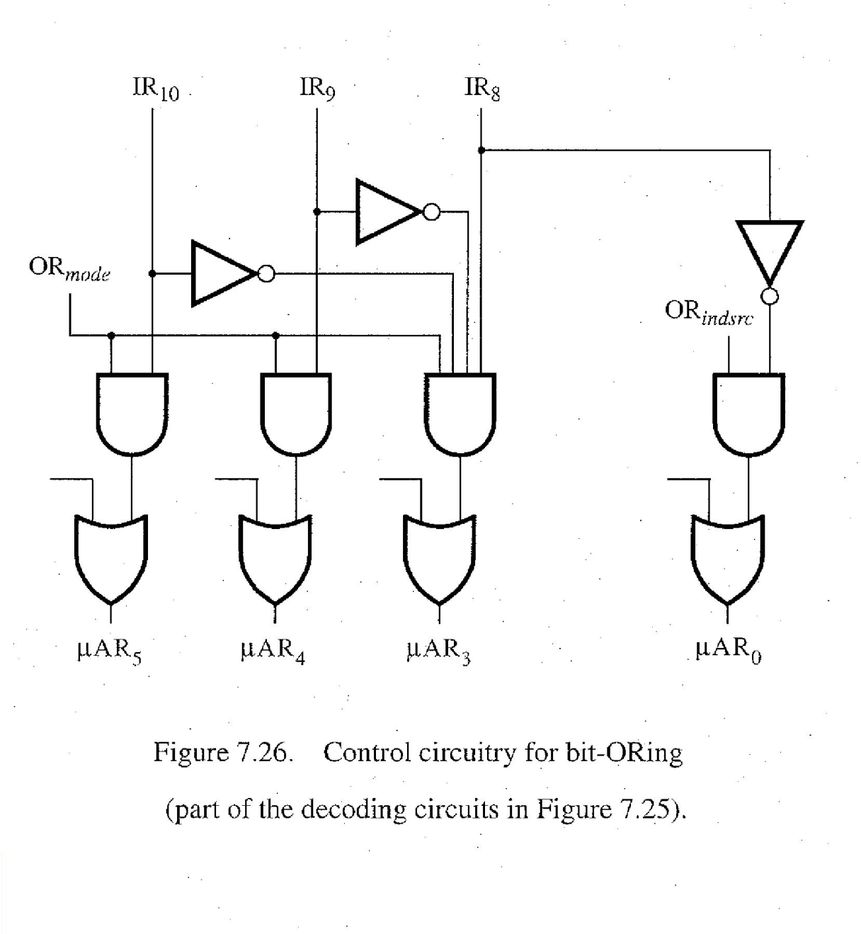
bit-ORing

Slide 84
Further Discussions
Prefetching
Emulation

Slide 85

Problems
Internal processor bus
Control signals
PC
Instruction decoder and control logic
Address lines
MAR
Memory bus
Data lines
MDR
IR
Y
Constant 4
R0
Select
MUX
Add
ALU
control lines
Sub
A B
R n - 1
ALU
XOR
Carry-in
TEMP
Z
Figure 7.1. Single-bus organization of the datapath inside a proc

Slide 86
Control Sequence of Add (R3), R1
Step
Action
1
2
3
4
5
6
7
PC_{out} , MAR _{in} , Read, Select4,Add, Z_{in} Zout , PCin , Yin , WMF C
MDR _{out} , IR _{in}
R3out , MAR in , Read R1out , Yin , WMF C MDR _{out} , SelectY, Add, Z_{in} Zout , R1in , End
Figure 7.6. Control sequencefor execution of the instruction Add (R3),R1.

